Slide 1

Predicting the term deposit subscription

Slide 2
Business Problem:
Business objective-
The data is related with direct marketing campaigns of a Portuguese banking institution. The marketing campaigns were based on phone calls. Often, more than one contact to the same client was required, in order to access if the product (bank term deposit) would be ('yes') or not ('no') subscribed.
The classification goal is to predict if the client will subscribe (yes/no) a term deposit (variable y)

Slide 3
Project Architecture / Project Flow
1.Understanding Business Objective
2.Getting data set details
3.EDA:Exploratory Data Analysis
4.Model Building
5.Evaluate the model
6.Data Visualizations
7.Deployment Frame

Slide 4
Exploratory Data Analysis (EDA) and
Feature Engineering

Slide 5
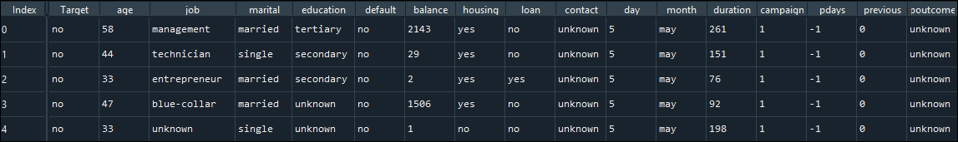
Data set details
1)The dataset is having 45211 observations.
2)It is having 17 columns and 45211 rows.
3)There are no missing values in the data set
4)The data set is having both the combination of categorical values and numeric values.So, we need to convert categorical values to numeric
5)There are no duplicate values in the data set.
6)The target column is the dependent variable with values yes or no
7)The top 5 rows of the data set is shown below.
7)Following are the columns in the data set:
Dependent Variable : 'Target', ‘
Independent Variables: age', 'job', 'marital', 'education', 'default', 'balance', 'housing', 'loan', 'contact’, 'day', 'month', 'duration', 'campaign', 'pdays', 'previous', 'poutcome'

Slide 6
Data set details
The data set details are as follows:
1)age (numeric)
2)job : type of job (categorical: 'admin.','blue-collar','entrepreneur','housemaid','management','retired','self employed','services','student','technician','unemployed','unknown’)
3)marital : marital status (categorical: 'divorced','married','single','unknown'; note: 'divorced' means
4)education : (categorical: 'primary', 'secondary', 'tertiary', 'unknown’)
5)default: has credit in default? (categorical: 'no','yes','unknown’)
6)housing: has housing loan? (categorical: 'no','yes','unknown’)
7)balance : average yearly balance, in euros (numeric)
8)loan: has personal loan? (categorical: 'no','yes','unknown’)
9)contact: contact communication type (categorical: 'cellular','telephone', 'unknown’)
10)month: last contact month of year (categorical: 'jan', 'feb', 'mar', ..., 'nov', 'dec’)
11)day: last contact day of the month (numeric 1 -31)
12)duration: last contact duration, in seconds (numeric).
13)campaign: number of contacts performed during this campaign and for this client (numeric, includes last contact)
14)pdays: number of days that passed by after the client was last contacted from a previous campaign (numeric; 999 means client was not previously contacted)
15)previous: number of contacts performed before this campaign and for this client (numeric)
16)poutcome: outcome of the previous marketing campaign (categorical: 'failure','other', 'unknown', 'success’)
17)target - has the client subscribed a term deposit? (binary: 'yes','no')

Slide 7
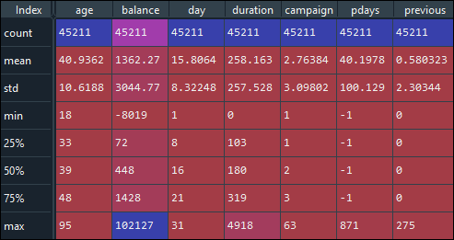
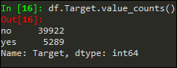
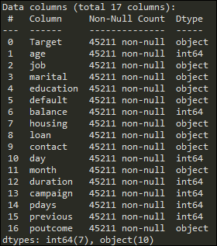
Data set details
Above table show the statistical analysis of the data set. It shows mean,median,mode,max values for the numeric feature.
The target column is the dependent variable with values yes or no. The target value count is (for no:39922 yes :5289
Left side table shows that data set down have any null values

Slide 8
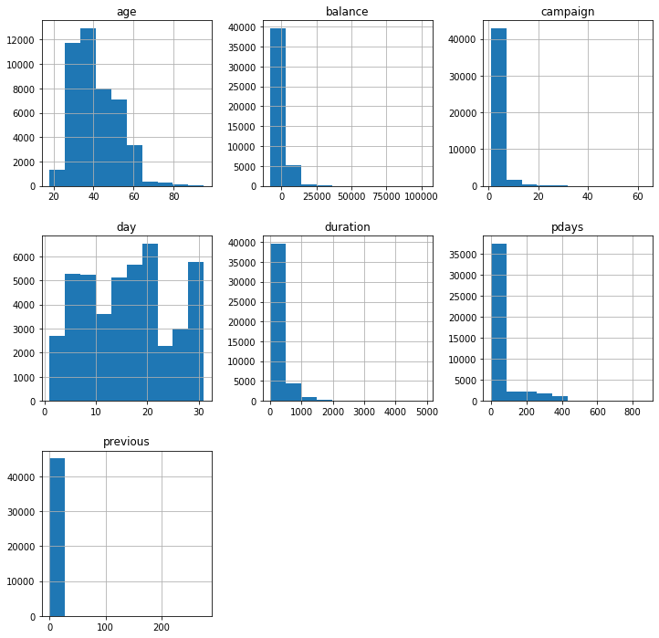
Data visualization :
1)The above plot is the histogram plot for the numeric features in the data set. We have job','marital','education','default','housing','loan','contact','month','poutcome’ these are in categorical values we need to convert some variable to dummy variable. A histogram makes it easier to identify different data, the frequency of its occurrence and categories

Slide 9
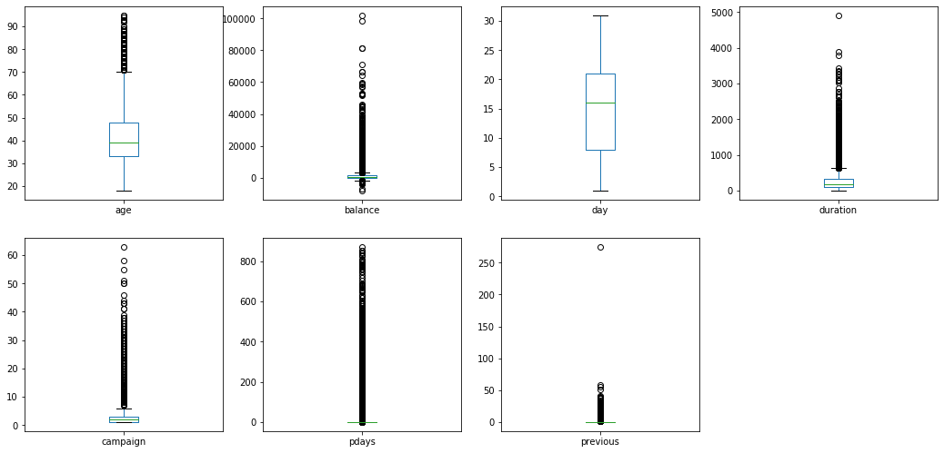
Data visualization :
1)The above plot is the box plot for the numeric features in the data set. The main advantage of boxplot is it shows outliers. An outlier is a data point that differs significantly from other observations.

Slide 10
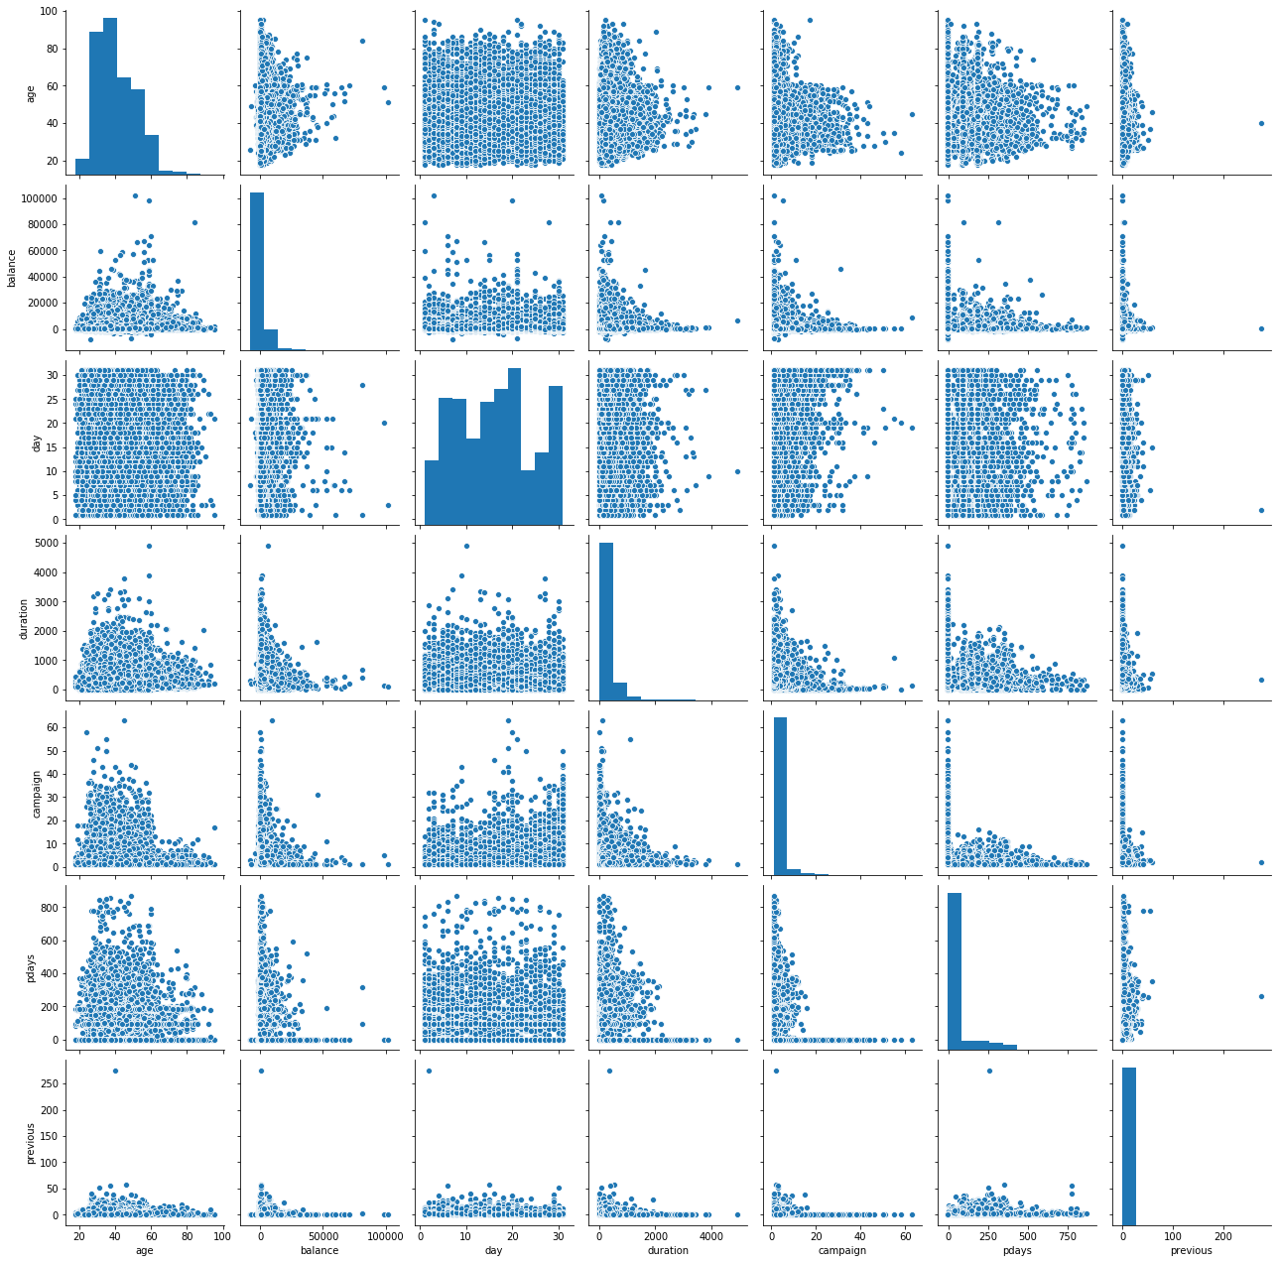
Data visualization :
1)The above plot represents the scatter plot for numeric features in the data set. A pairplot plot a pairwise relationships in a dataset. A “pairplot” is also known as a scatterplot, in which one variable in the same data row is matched with another variable's value,.

Slide 11
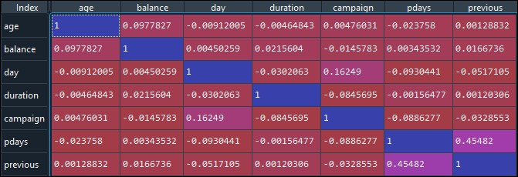
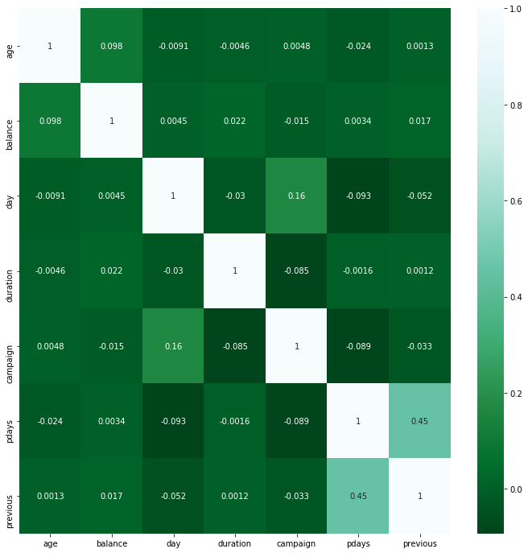
Data set details
1)The above plot represents correlation plot for numeric features in the data set. A correlation matrix is a table showing correlation coefficients between variables. Each cell in the table shows the correlation between two variables. A correlation matrix is used to summarize data, as an input into a more advanced analysis, and as a diagnostic for advanced analyses.
1) The diagram shows the heat map for numeric features in the data set.Heatmaps provide a visual approach to understanding numeric values. It is a representation of data in the form of a map or diagram in which data values are represented as colours. A heat map is data analysis software that uses color the way a bar graph uses height and width: as a data visualization tool.

Slide 12
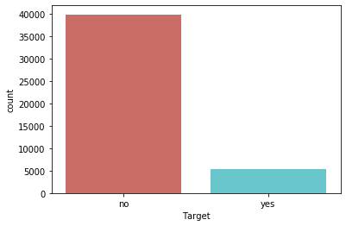
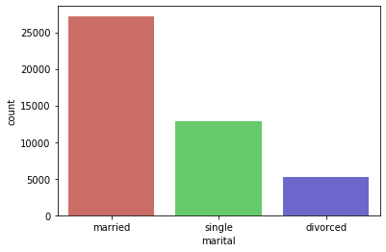
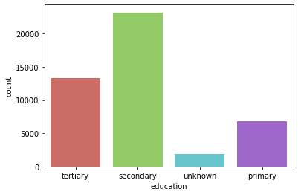
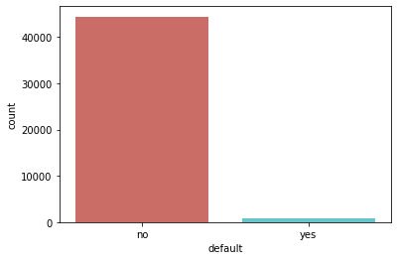
Data visualization :
We have few features which are categorical so we have to convert them to numeric. job','marital','education','default','housing','loan','contact','month','poutcome’ these are in categorical values we need to convert some variable to dummy variable. Below are the count plots for categorical features which we can get insights from it.

Slide 13
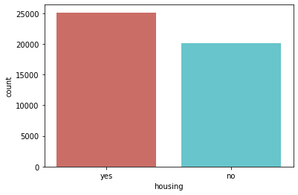
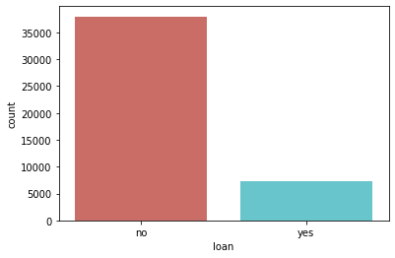
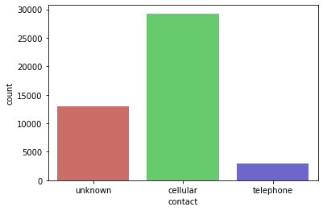
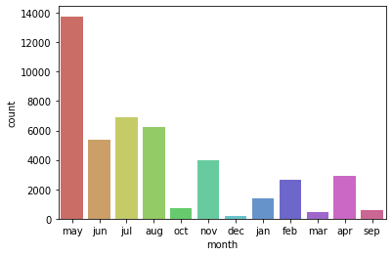
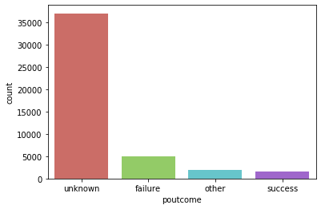
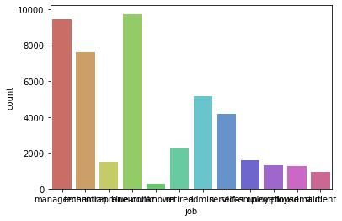
Data visualization :

Slide 14
Model Building

Slide 15
Model Building
Following are the models used for Model building in this project:
1)Logistic regression.
2)Decision tree classifier.
3) Random forest classifier.
4) Extra tree classifier.
5) Support Vector Machine(SVM) Classifier.
6)Neural Networks
7)Bagging classifier method.
8)Catboost Classifier
9)XGB Classifier

Slide 16
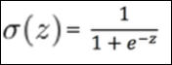
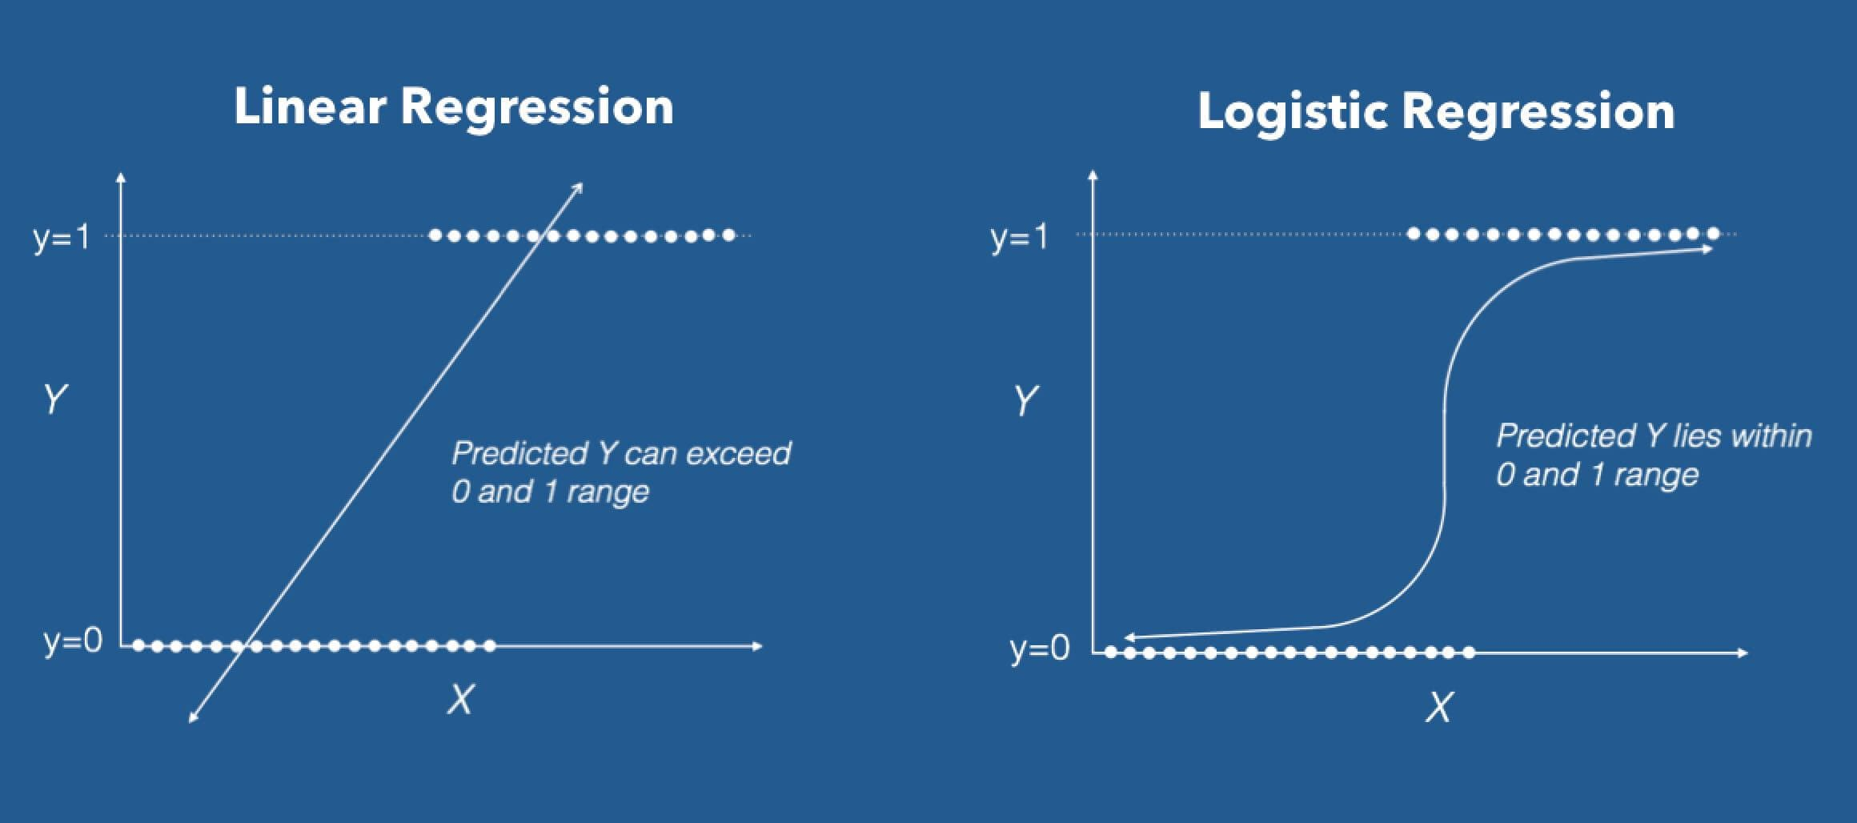
Logistic regression:
1)Logistic regression is often referred as logit model is a technique used to predict the probability associated with each dependent variable category.
2)Logistic Regression Model is a generalized form of Linear Regression Model. It is a very good Discrimination Tool.
3)Logistic Regression measures the relationship between the dependent variable (our label, what we want to predict) and the one or more independent variables (our features), by estimating probabilities using it’s underlying logistic function.
4)The probability in logistic regression curve can be given by :

Slide 17
Logistic regression:
Advantages of Logistic Regression:
1. Logistic Regression performs well when the dataset is linearly separable. 2. Logistic regression is less prone to over-fitting but it can overfit in high dimensional datasets. You should consider Regularization (L1 and L2) techniques to avoid over-fitting in these scenarios. 3. Logistic Regression not only gives a measure of how relevant a predictor (coefficient size) is, but also its direction of association (positive or negative). 4. Logistic regression is easier to implement, interpret and very efficient to train. Disadvantages of Logistic Regression:
1. Main limitation of Logistic Regression is the assumption of linearity between the dependent variable and the independent variables. In the real world, the data is rarely linearly separable. Most of the time data would be a jumbled mess. 2. If the number of observations are lesser than the number of features, Logistic Regression should not be used, otherwise it may lead to overfit. 3. Logistic Regression can only be used to predict discrete functions. Therefore, the dependent variable of Logistic Regression is restricted to the discrete number set. This restriction itself is problematic, as it is prohibitive to the prediction of continuous data

Slide 18

Decision tree classifier :
1)It is called as Greedy algorithm and Supervised classification model.
2)Decision tree algorithm is like a tree like structure where it is the combination of root node ,branch node and leaf nodes.
3)With the help of Entropy and Information gain we have to choose Root node.
4)Outcomes here are leaf nodes.
5)Overfitting is the main problem in decision tree classifier. As the model overfits we call it as greedy. We can go with pruning method for removing the branches without removing the information.
Root Node: Root node is from where the decision tree starts. It represents the entire dataset, which further gets divided into two or more homogeneous sets.
Leaf Node: Leaf nodes are the final output node, and the tree cannot be segregated further after getting a leaf node.
Splitting: Splitting is the process of dividing the decision node/root node into sub-nodes according to the given conditions.
Branch/Sub Tree: A tree formed by splitting the tree.

Slide 19
Decision tree classifier :
Advantages of the Decision Tree:
1)It is simple to understand as it follows the same process which a human follow while making any decision in real-life.
2)It can be very useful for solving decision-related problems.
3)It helps to think about all the possible outcomes for a problem.
4)There is less requirement of data cleaning compared to other algorithms.
Disadvantages of the Decision Tree:
1)The decision tree contains lots of layers, which makes it complex.
2)It may have an overfitting issue, which can be resolved using the Random Forest algorithm.
3) For more class labels, the computational complexity of the decision tree may increase.

Slide 20
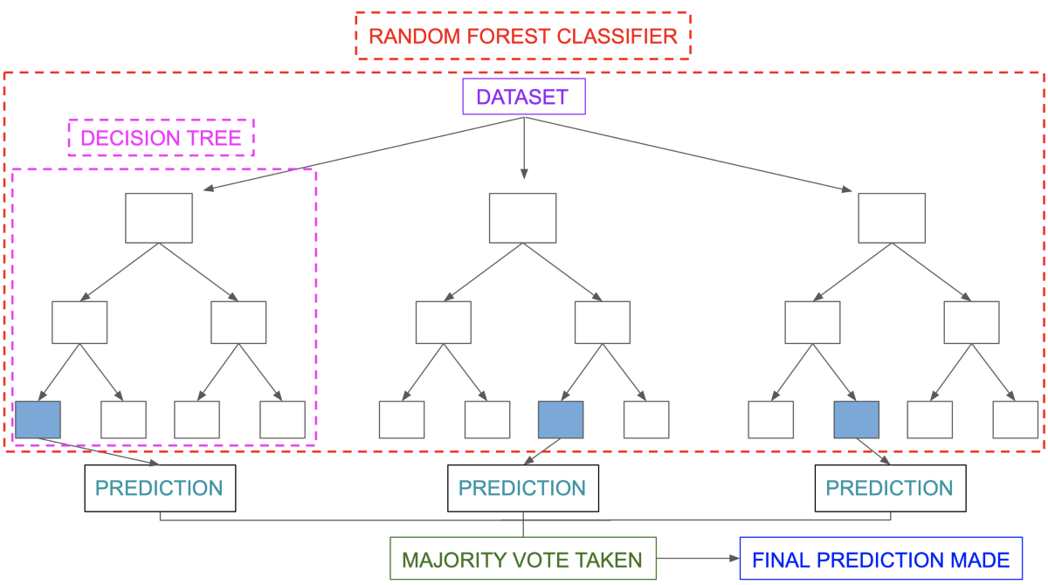
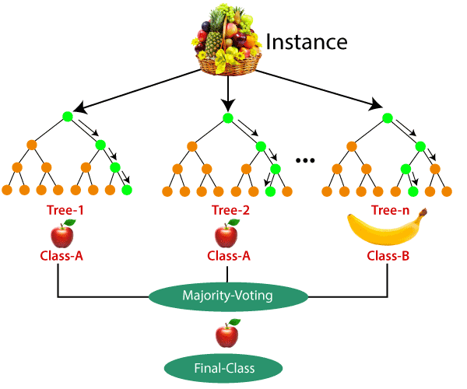
Random Forest classifier :
Random Forest is a popular machine learning algorithm that belongs to the supervised learning technique. It is combination of multiple decision tress. Its is an ensemble method.
Random Forest is a classifier that contains a number of decision trees on various subsets of the given dataset and takes the average to improve the predictive accuracy of that dataset.
The greater number of trees in the forest leads to higher accuracy and prevents the problem of overfitting.

Slide 21
Random Forest classifier :
Advantages of Random Forest:
1)Random Forest is capable of performing both Classification and Regression tasks.
2)It is capable of handling large datasets with high dimensionality.
3)t enhances the accuracy of the model and prevents the overfitting issue.
4)It can handle null values in the data set.
Disadvantages of Random Forest:
1)Although random forest can be used for both classification and regression tasks, it is not more suitable for Regression tasks.
Bagging Classifier :
Bagging is a technique that can be used to improve the accuracy of Classification & Regression Trees (CART).They’re known as ‘ensemble’ methods.
Bagging reduces overfitting (variance) by averaging or voting, however, this leads to an increase in bias, which is compensated by the reduction in variance though.
A Bagging classifier is an ensemble meta-estimator that fits base classifiers each on random subsets of the original dataset and then aggregate their individual predictions (either by voting or by averaging) to form a final prediction.

Slide 22
Extra tree classifier:
The Extra Trees algorithm works by creating a large number of unpruned decision trees from the training dataset. Predictions are made by averaging the prediction of the decision trees in the case of regression or using majority voting in the case of classification
ExtraTreesClassifier is an ensemble learning method fundamentally based on decision trees. ExtraTreesClassifier, like RandomForest, randomizes certain decisions and subsets of data to minimize over-learning from the data and overfitting.
Extra Trees is like Random Forest, in that it builds multiple trees and splits nodes using random subsets of features, but with two key differences: it does not bootstrap observations (meaning it samples without replacement), and nodes are split on random splits, not best splits. So, in summary,
ExtraTrees:
1) builds multiple trees with bootstrap = False by default, which means it samples without replacement
2)nodes are split based on random splits among a random subset of the features selected at every node
4)In concept, it is very similar to a Random Forest Classifier and only differs from it in the manner of construction of the decision trees in the forest.Also called as Extremely Randomized Trees Classifier(Extra Trees Classifier)

Slide 23
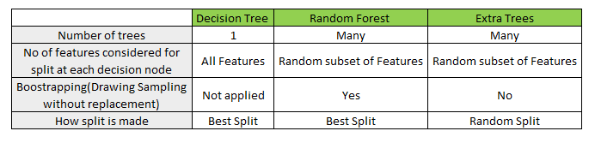
Extra tree classifier:
Major difference between Decision tree ,Radom forest and Extra trees classifier.

Slide 24

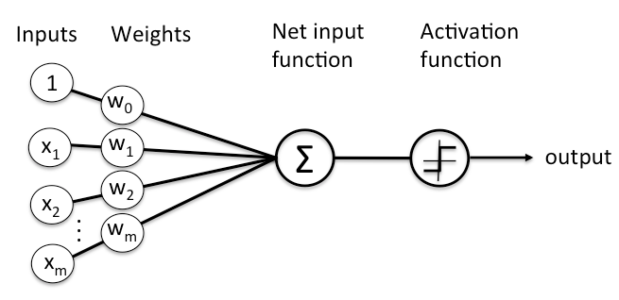
Neural Networks :
A neural network is a network or circuit of neurons, or in a modern sense, an artificial neural network, composed of artificial neurons or nodes. Thus a neural network is either a biological neural network, made up of real biological neurons, or an artificial neural network, for solving artificial intelligence(AI) problems.
Neural network architecture :

Slide 25
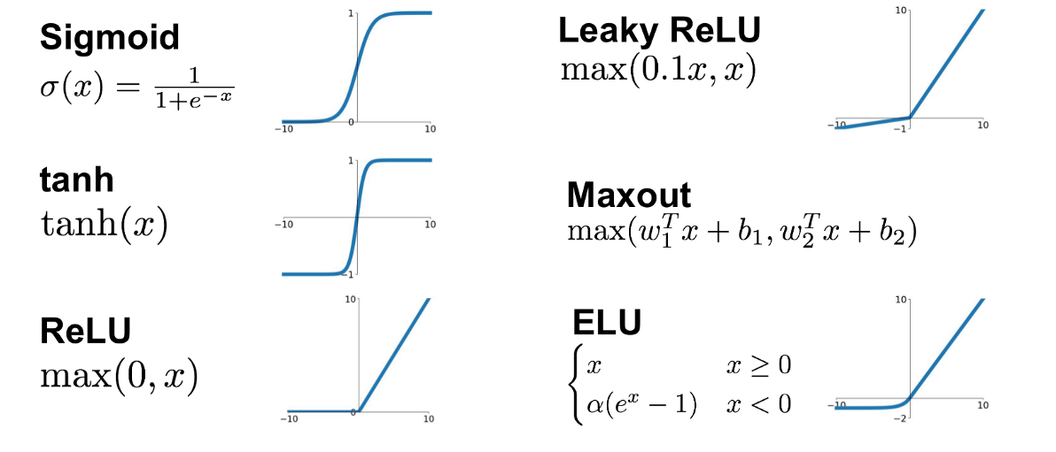
Neural Networks :
Different types of Activation functions:

Slide 26


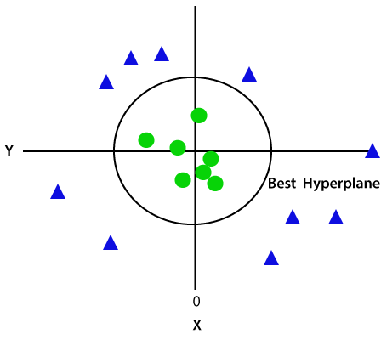
Support Vector Machine(SVM) Classifier:
Support Vector Machine or SVM is one of the most popular Supervised Learning algorithms, which is used for Classification as well as Regression problems.
The goal of the SVM algorithm is to create the best line or decision boundary that can segregate n-dimensional space into classes so that we can easily put the new data point in the correct category in the future. This best decision boundary is called a hyperplane.
SVM is of two types .a)Linear SVM : It is used for linearly separable data, which means if a dataset can be classified into two classes by using a single straight line, then such data is termed as linearly separable data, and classifier is used called as Linear SVM classifier.
b) Non-linear SVM: Non-Linear SVM is used for non-linearly separated data, which means if a dataset cannot be classified by using a straight line, then such data is termed as non-linear data and classifier used is called as Non-linear SVM classifier.

Slide 27
Catboost Classifier:
1)A machine learning library to handle categorical (CAT) data automatically.
2) “CatBoost” name comes from two words “Category” and “Boosting”.
3) CatBoost is an algorithm for gradient boosting on decision trees. It is developed by Yandex researchers and engineers, and is used for search, recommendation systems, personal assistant, self-driving cars, weather prediction and many other tasks at Yandex and in other companies, including CERN, Cloudflare, Careem taxi.
4) Catboost is built with similar approach and attributes as with the "older" generation of GBDT models.
5)Catboost power lies with categorical features preprocessing, prediction time and model analysis.
XGB Classifier:
XGBoost is an optimized distributed gradient boosting library designed to be highly efficient, flexible and portable. It implements machine learning algorithms under the Gradient Boosting framework. XGBoost provides a parallel tree boosting (also known as GBDT, GBM) that solve many data science problems in a fast and accurate way. The same code runs on major distributed environment (Hadoop, SGE, MPI) and can solve problems beyond billions of examples.

Slide 28

XGB Classifier:
1)XGBoost is a powerful machine learning algorithm especially where speed and accuracy are concerned.
2)We need to consider different parameters and their values to be specified while implementing an XGBoost model.
3)The XGBoost model requires parameter tuning to improve and fully leverage its advantages over other algorithms.
The XGBoost Advantages :
Regularization-help to reduce over fitting
Parallel Processing
High Flexibility
Handling Missing Values
Built-in Cross-Validation
Continue on Existing Model

Slide 29
Model building Results before SMOTE:
Model Used | num | Precision | Recall | f1-score | Number of errors | Testing_ Accuracy | Training_ Accuracy
Logistic Regression | no | 0.92 | 0.98 | 0.95 | 1288 | 0.9 | 0.9
 | yes | 0.67 | 0.35 | 0.46
Decision Tree Classifier | no | 0.93 | 0.93 | 0.93 | 1673 | 0.87 | 1
 | yes | 0.47 | 0.48 | 0.48
Random Forest Classifier | no | 0.92 | 0.97 | 0.95 | 1265 | 0.9 | 0.99
 | yes | 0.67 | 0.39 | 0.49
Extra tree Classifier | no | 0.92 | 0.97 | 0.95 | 1330 | 0.9 | 1
 | yes | 0.64 | 0.35 | 0.45
SVM Classifier | no | 0.92 | 0.98 | 0.95 | 1316 | 0.9 | 0.91
 | yes | 0.67 | 0.32 | 0.44
Neural Networks | no | 0.93 | 0.96 | 0.95 | 1324 | 0.9 | 0.9
 | yes | 0.6 | 0.48 | 0.54
Bagging Classifier | no | 0.92 | 0.97 | 0.95 | 1329 | 0.9 | 0.99
 | yes | 0.62 | 0.4 | 0.49
Catboost Classifier | no | 0.93 | 0.97 | 0.95 | 1231 | 0.9 | 0.94
 | yes | 0.65 | 0.48 | 0.55
XGB Classifier | no | 0.93 | 0.96 | 0.95 | 1261 | 0.9 | 0.95
 | yes | 0.63 | 0.48 | 0.54
Linear SVM Classifier | no | 0.92 | 0.98 | 0.95 | 1312 | 0.9 | 0.89
 | yes | 0.68 | 0.31 | 0.43
Observation: From the results off all the classification models we can infer that there is a class imbalance problem in the data set.
How to solve Class Imbalance?
By using SMOTE technique we are trying to solve class imbalance problem
SMOTE : stands for Synthetic Minority Oversampling Technique. This is a statistical technique for increasing the number of cases in your dataset in a balanced way. The module works by generating new instances from existing minority cases that you supply as input.

Slide 30
Model building Results after SMOTE:
Model Used | num | Precision | Recall | f1-score | Number of errors | Testing_Accuracy | Training_Accuracy
Logistic Regression | no | 0.92 | 0.98 | 0.95 | 1288 | 0.9 | 0.9
 | yes | 0.67 | 0.35 | 0.46
Decision Tree Classifier | no | 0.93 | 0.93 | 0.93 | 1673 | 0.87 | 1
 | yes | 0.47 | 0.48 | 0.48
Random Forest Classifier | no | 0.92 | 0.97 | 0.95 | 1265 | 0.9 | 0.99
 | yes | 0.67 | 0.39 | 0.49
Extra tree Classifier | no | 0.92 | 0.97 | 0.95 | 1330 | 0.9 | 1
 | yes | 0.64 | 0.35 | 0.45
SVM Classifier | no | 0.92 | 0.98 | 0.95 | 1316 | 0.9 | 0.91
 | yes | 0.67 | 0.32 | 0.44
Neural Networks | no | 0.93 | 0.96 | 0.95 | 1324 | 0.9 | 0.9
 | yes | 0.6 | 0.48 | 0.54
Bagging Classifier | no | 0.92 | 0.97 | 0.95 | 1329 | 0.9 | 0.99
 | yes | 0.62 | 0.4 | 0.49
Catboost Classifier | no | 0.93 | 0.97 | 0.95 | 1231 | 0.9 | 0.94
 | yes | 0.65 | 0.48 | 0.55
XGB Classifier | no | 0.93 | 0.96 | 0.95 | 1261 | 0.9 | 0.95
 | yes | 0.63 | 0.48 | 0.54
Linear SVM Classifier | no | 0.92 | 0.98 | 0.95 | 1312 | 0.9 | 0.89
 | yes | 0.68 | 0.31 | 0.43

Slide 31
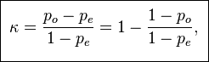
cohen_kappa_score:
Before SMOTE:
After SMOTE:
Model Used | cohen_kappa_score
Logistic Regression | 0.41
Decision Tree Classifier | 0.4
Random Forest Classifier | 0.44
Extra tree Classifier | 0.4
SVM Classifier | 0.38
Neural Networks | 0.48
Bagging Classifier | 0.43
Catboost Classifier | 0.5
XGB Classifier | 0.49
Linear SVM Classifier | 0.38
Model Used | cohen_kappa_score
Logistic Regression | 0.47
Decision Tree Classifier | 0.4
Random Forest Classifier | 0.511
Extra tree Classifier | 0.44
SVM Classifier | 0.5
Neural Networks | 0.49
Bagging Classifier | 0.48
Catboost Classifier | 0.54
XGB Classifier | 0.53
Linear SVM Classifier | 0.47
Cohen_kappa_Score:
1)Cohen’s Kappa statistic is a very useful, but under-utilised, metric. Sometimes in machine learning we are faced with a multi-class classification problem. In those cases, measures such as the accuracy, or precision/recall do not provide the complete picture of the performance of our classifier. In some other cases we might face a problem with imbalanced classes(Majority class and minority class problems)
2) Cohen’s kappa statistic is a very good measure that can handle very well both multi-class and imbalanced class problems.
3) Cohen’s kappa is given by the formula:
Where : where po is the observed agreement, and pe is the expected agreement.

Slide 32
Evaluation step:
1)From all model building results we can conclude that cohen_kappa_Score for Catboost classifier model is 0.54 which is moderate and good compared to other models ,Number of predicting errors = 1231 which is less compared to other models. Testing Accuracy is high 90 %. So the final model is Catboost classifier.
2)Precision = Quality of prediction .
3)Recall = Measurement of coverage.
4) Cohen_kappa_Score : Cohen’s kappa is always less than or equal to 1. Values of 0 or less, indicate that the classifier is useless. There is no standardized way to interpret its values. Landis and Koch (1977) provide a way to characterize values. According to their scheme a value < 0 is indicating no agreement , 0–0.20 as slight, 0.21–0.40 as fair, 0.41–0.60 as moderate, 0.61–0.80 as substantial, and 0.81–1 as almost perfect agreement.

Slide 33

Model Deployment using

Slide 34
Model Deployment
The Model Deployed is Catboost Classifier
For deployment we have created files like app.py and Model.pkl.
CatboostClassifier(Higher Accuracy Model) saved as to Model.pkl.
And app.py is the Flask deployment code.

Slide 35
Deployment Using flask
Flask File Creation:
Import Flask from flask module
Create an instance of the Flask class
We use @app.route(‘/’) to execute home function and @app.route(‘/predict’, methods=[POST]) to execute predict function
Using which gives results page for this use index.html
After execute whole deployment code it gives link like http://127.0.0:5000 run this link to get results.

Slide 36
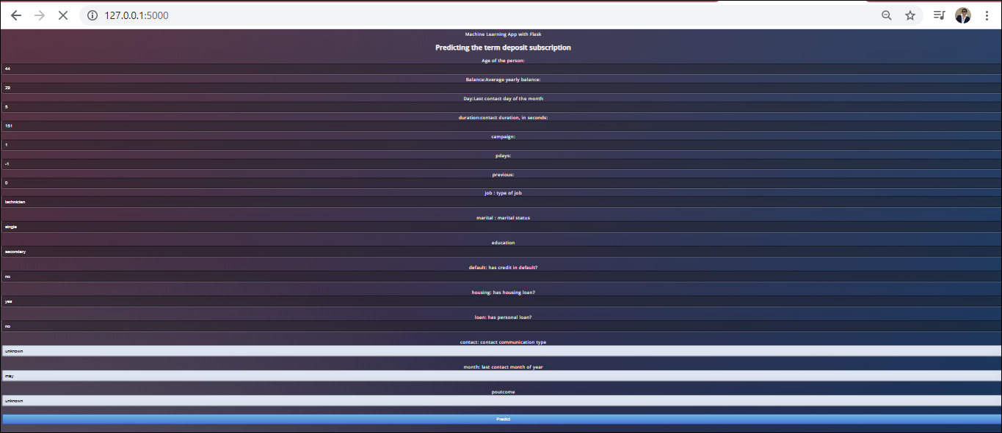
Results:

Slide 37
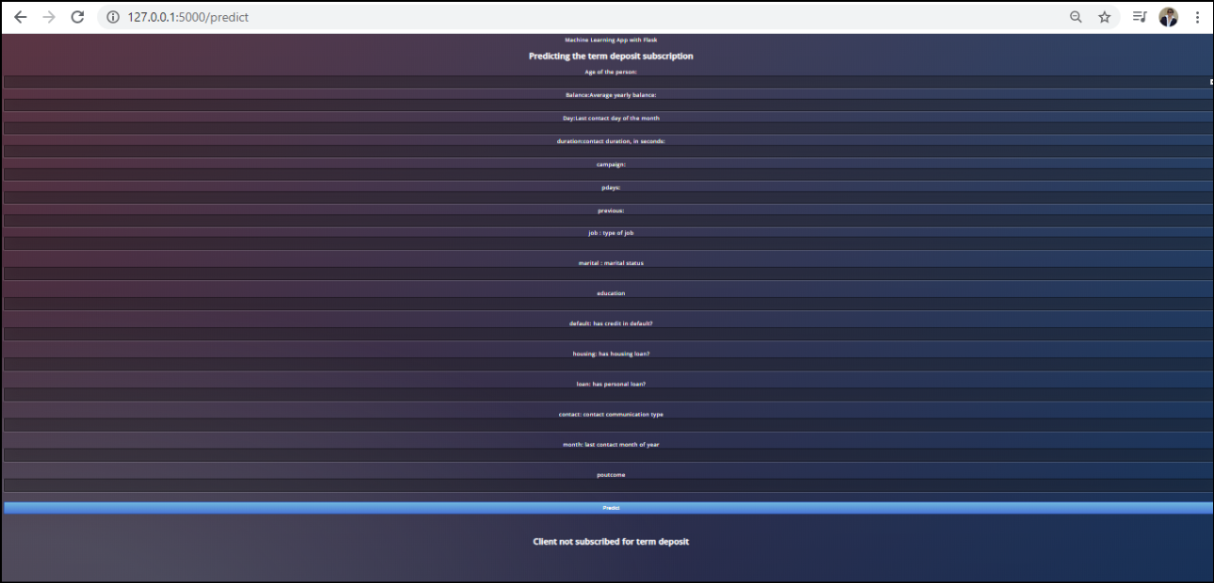
Results:

Slide 38
Thank you

